Slide 1

Duncke Softwares

Slide 2


Slide 3

D
S
Duncke Softwares

Slide 4
D
S
Duncke Softwares

Slide 5
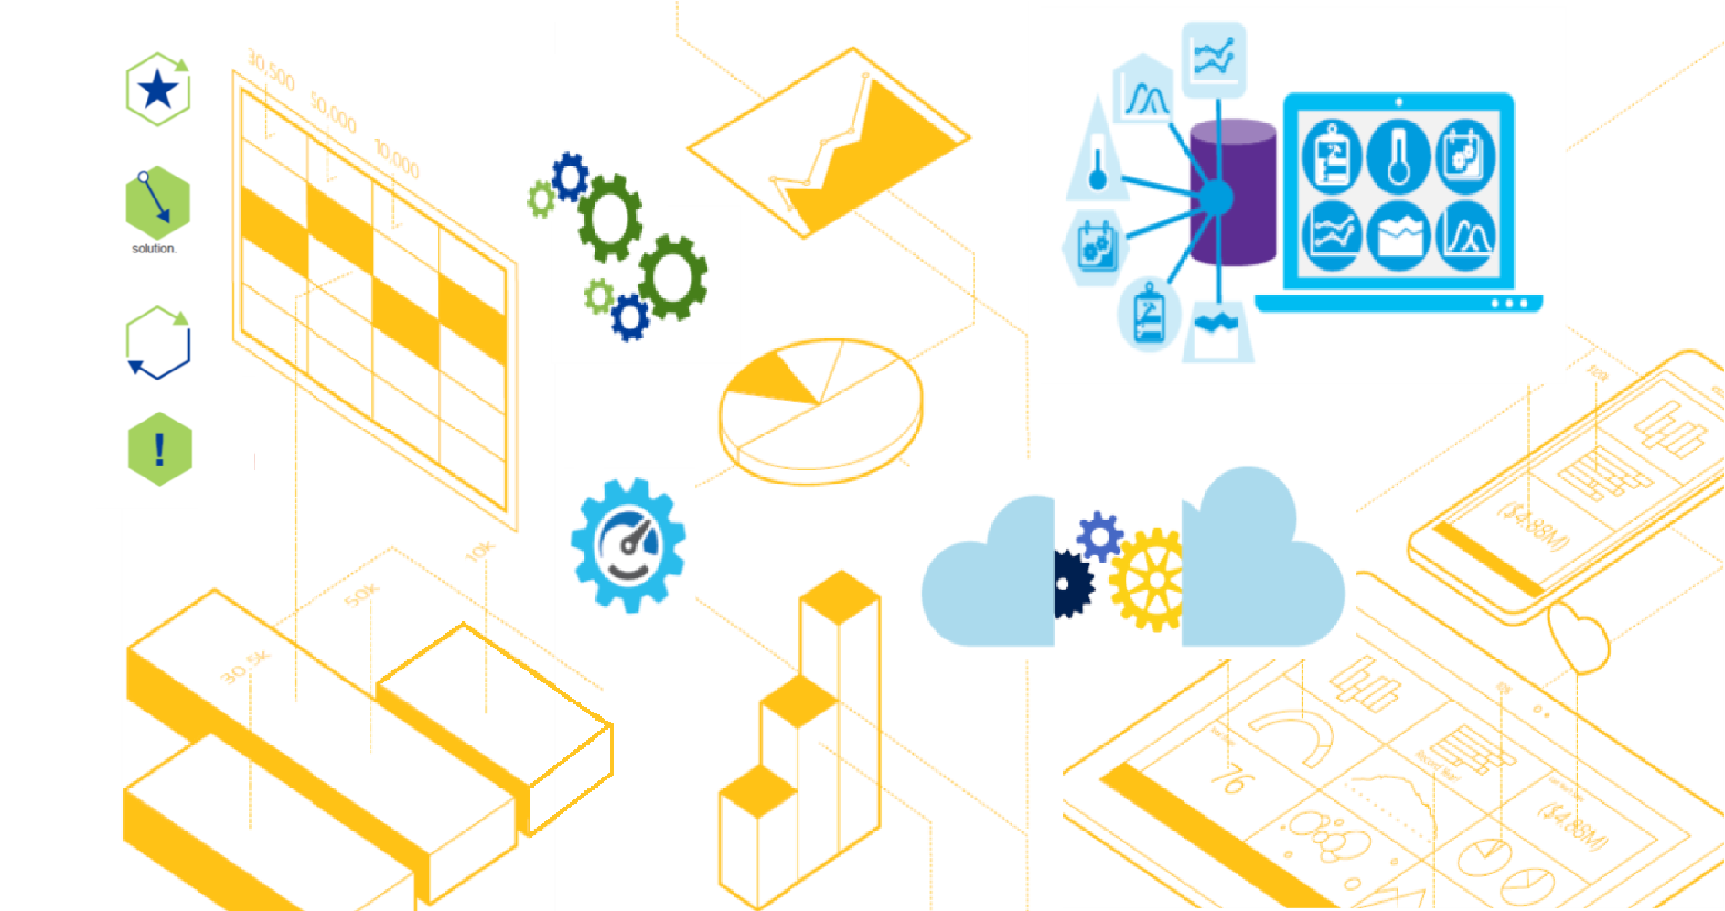

Slide 6


Slide 7

Duncke Softwares

Slide 8
D
S
Duncke Softwares

